Slide 1
Analysis of target capture based sequencing data
RIM Software/CZID

Slide 2
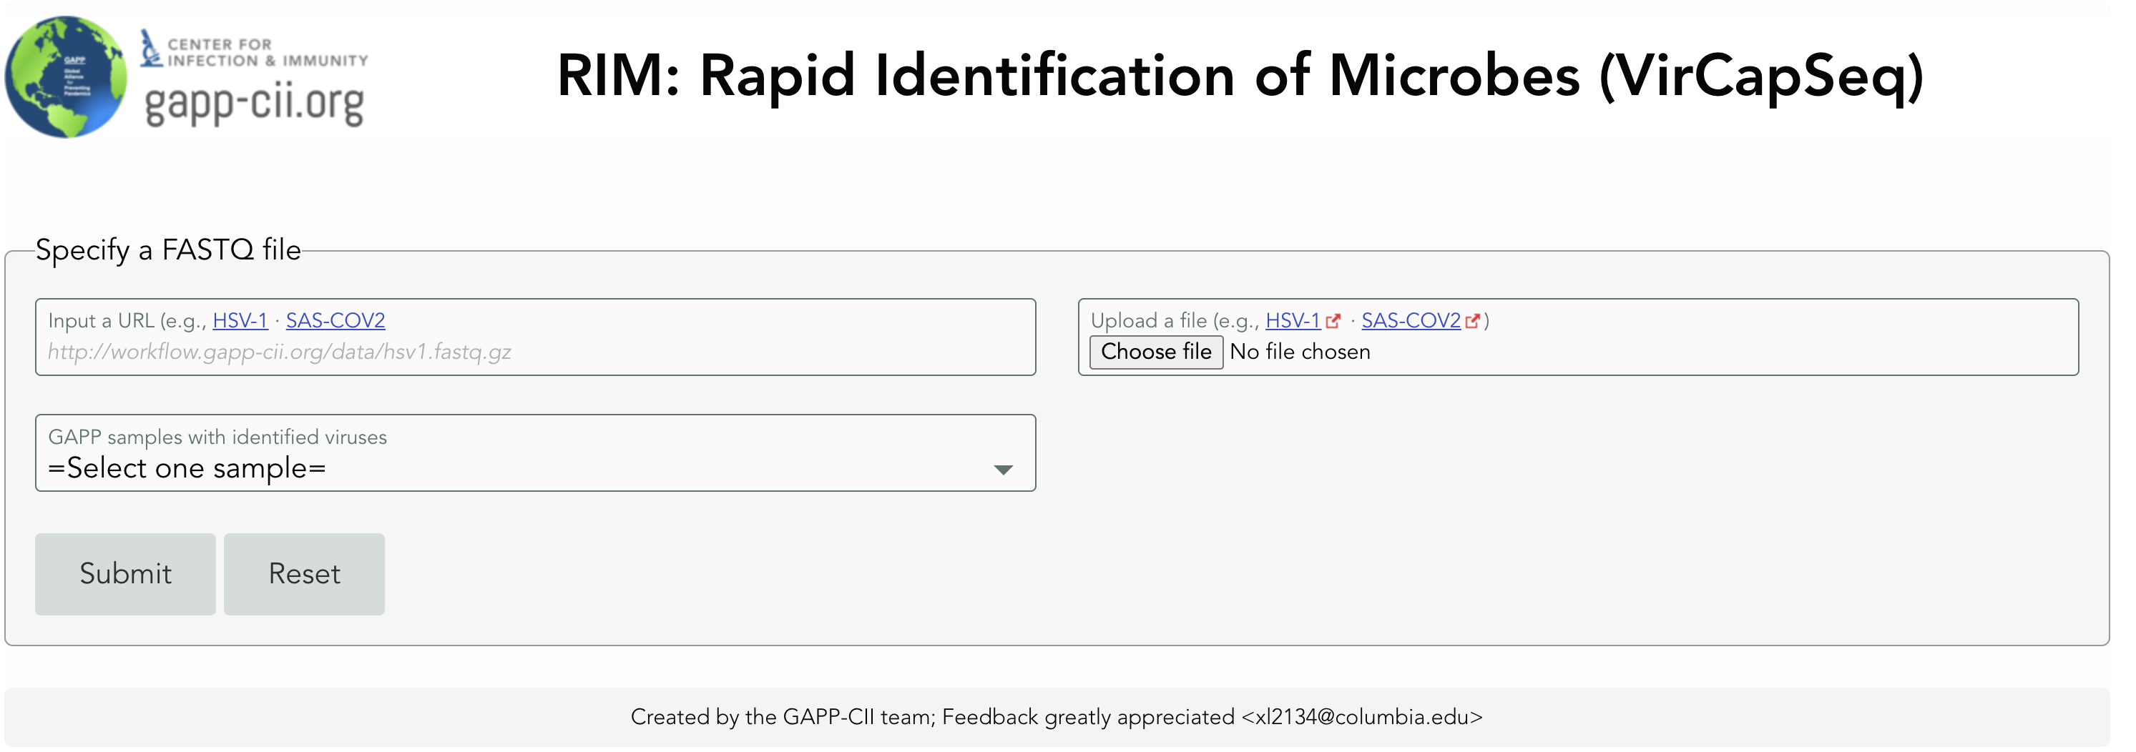
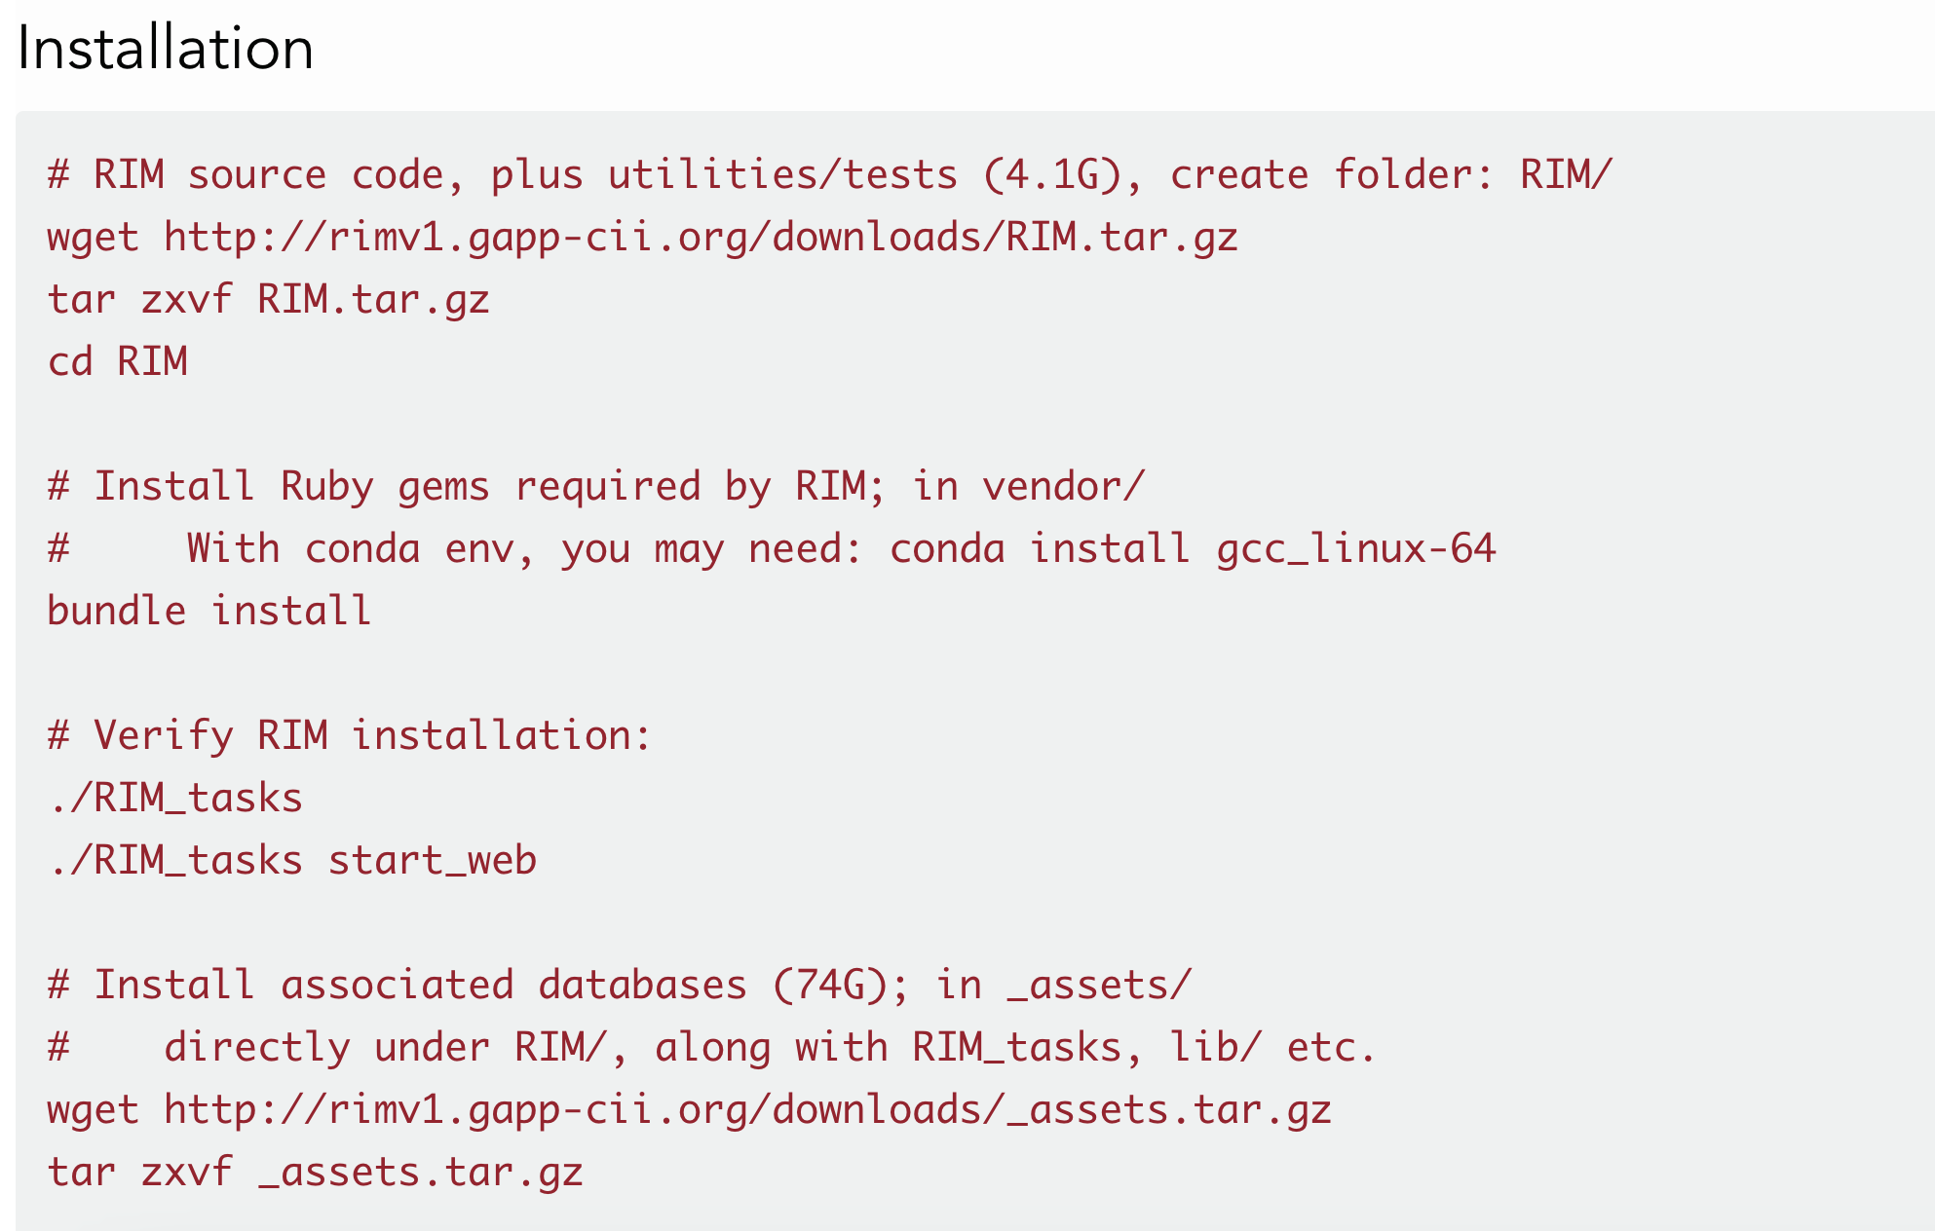
Introduction-RIM analysis software
http://rimv1.gapp-cii.org/downloads/
RIM employs Docker or Singularity to containerize third-party bioinformatics tools (such as blast, kraken2, and bowtie2)
RIM uses Ruby to drive the analysis workflow, and to share results via an interactive web application

Slide 3
Introduction-CZID
CZID - An open source cloud-based pipeline and analysis service for metagenomic pathogen detection and monitoring.
Metagenomic next-generation sequencing (mNGS) of nucleic acid from biological samples offers the potential for a universal pathogen detection method.
Including the detection of novel species.
CZID is a continuously evolving service that enables robust and reproducible analysis of mNGS data for microbial identification, regardless of sample type or host species.

Slide 4
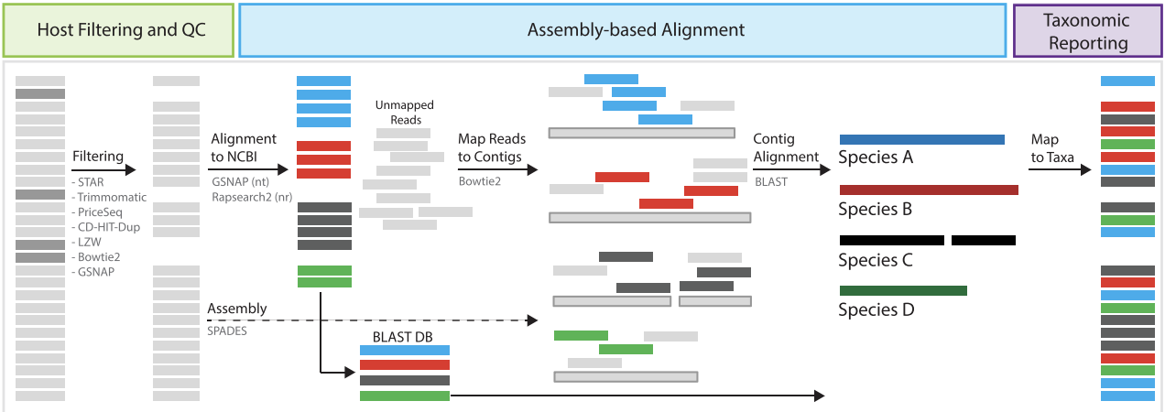
Analysis
The CZID pipeline ingests raw, short-read sequencing data (either RNA- or DNA-sequencing from any sample type).
Sequence analysis proceeds through 3 main phases:

Slide 5
Analysis pipelines
RIM
CZID
Developed by the GAPP team
Command line based
Requires some experience
Easier to troubleshoot
Developed by third party
Graphical User interface
Easy to use
Much more difficult to troubleshoot

Slide 6
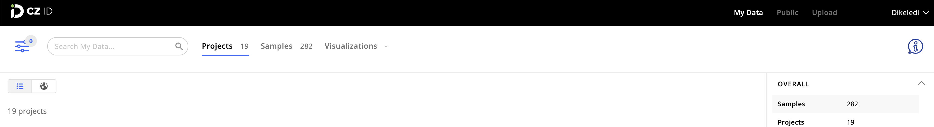
Upload data

Slide 7
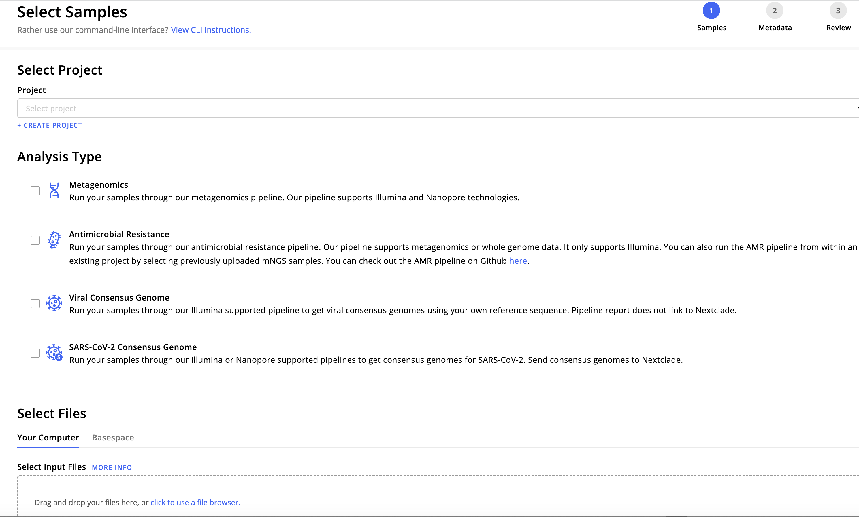
Choose pipeline
Can upload illumina/nanopore data. But it is not pathogen specific so it will detect influenza and you can get a consensus
Choose both to also get the quality matrices
You can select and upload your own reference. Only for Illumina
Only for SARS. Illumina and Nanopore

Slide 8
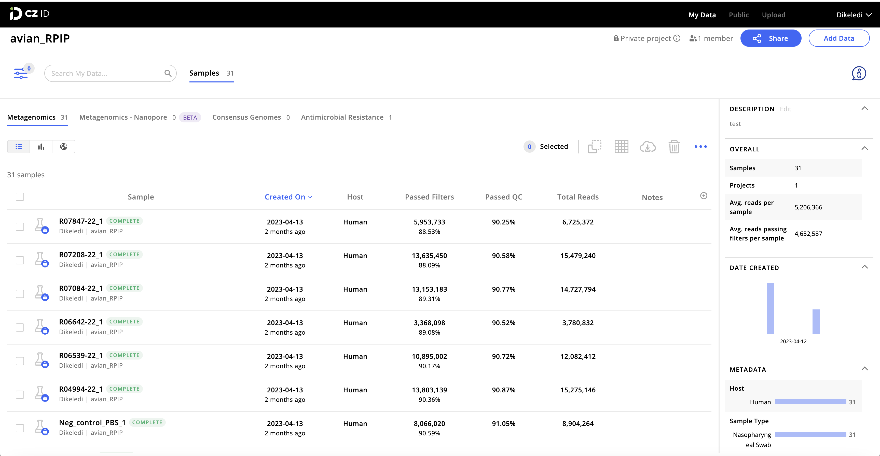
Results
Results for each sample
General run info
Sample QC

Slide 9
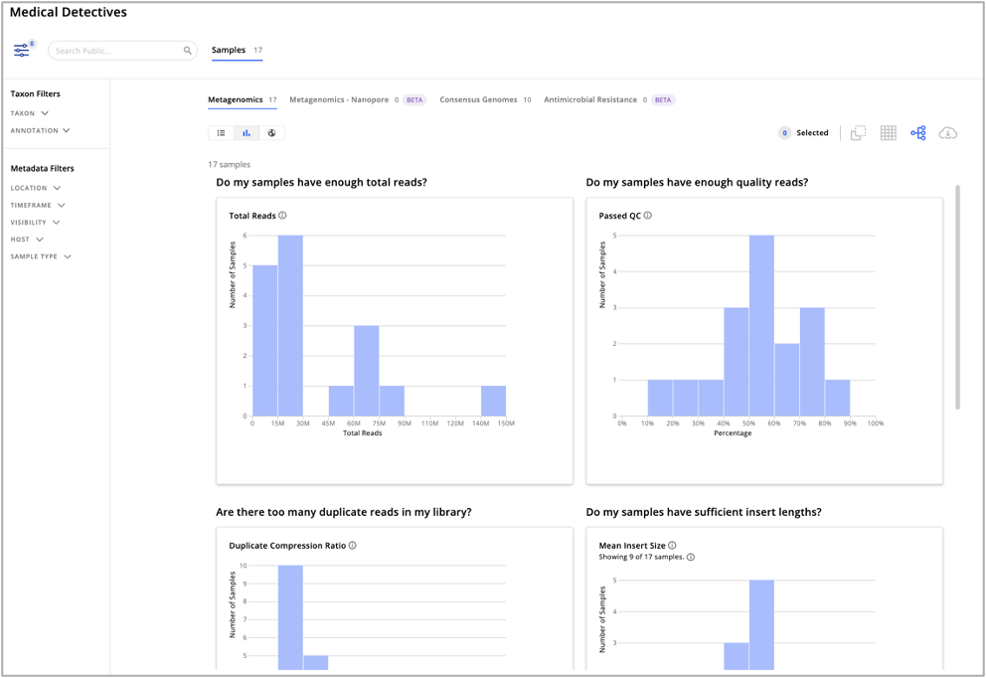
Sample QC
Pipeline QC steps
Initial host filtration using STAR
Trim sequencing adapters using Trimmomatic
Quality filter using PriceSeq
Identify duplicate reads using czid-dedup (note: prior to pipeline version 6.0, CZ ID used CD-HIT-DUP for duplicate identification)
Filter out low complexity sequences using LZW
Filter out remaining host sequences using Bowtie2
Subsampling to 1 million fragments (reads/read-pairs) if > 1M remain after step (6)
Filter out human sequences, regardless of host (using STAR, Bowtie2, and GSNAP)

Slide 10
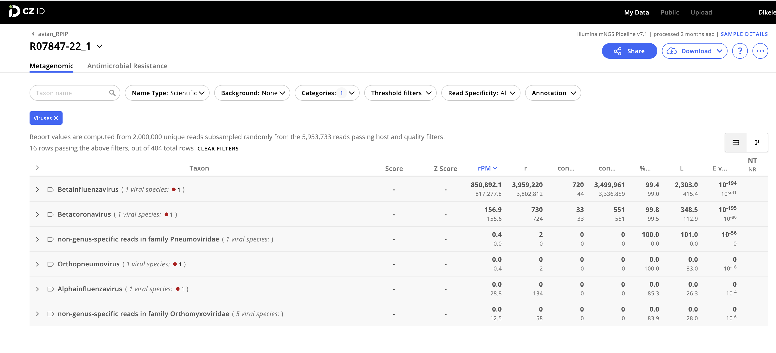
Sample results: metagenomics

Slide 11
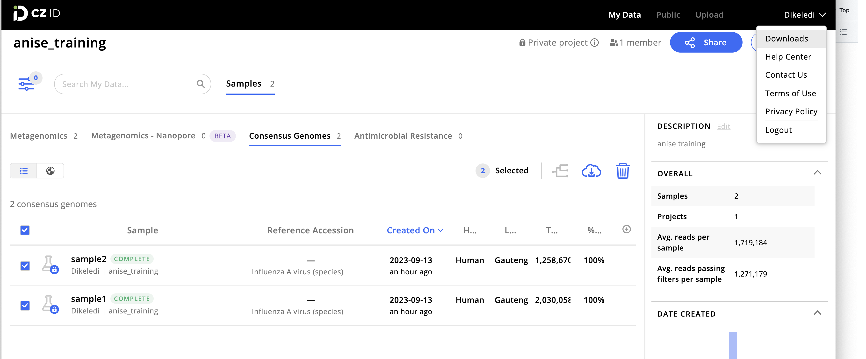
Sample results: Consensus file

Slide 12
Sample results: Consensus file
This is where you will find the downloads
Mark all isolates
This is where you choose the type of download you want

Slide 13
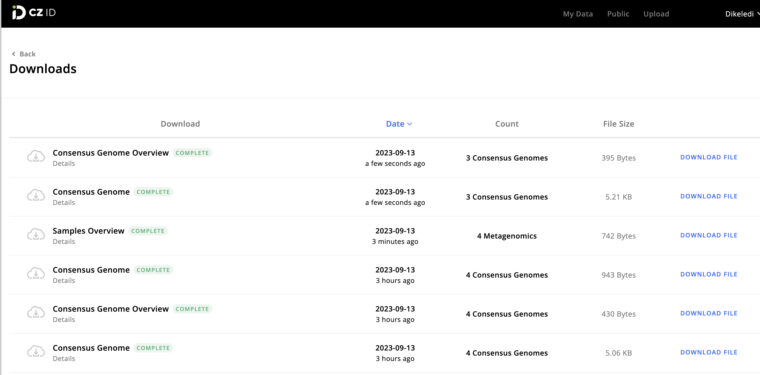
Downloads page

Slide 14
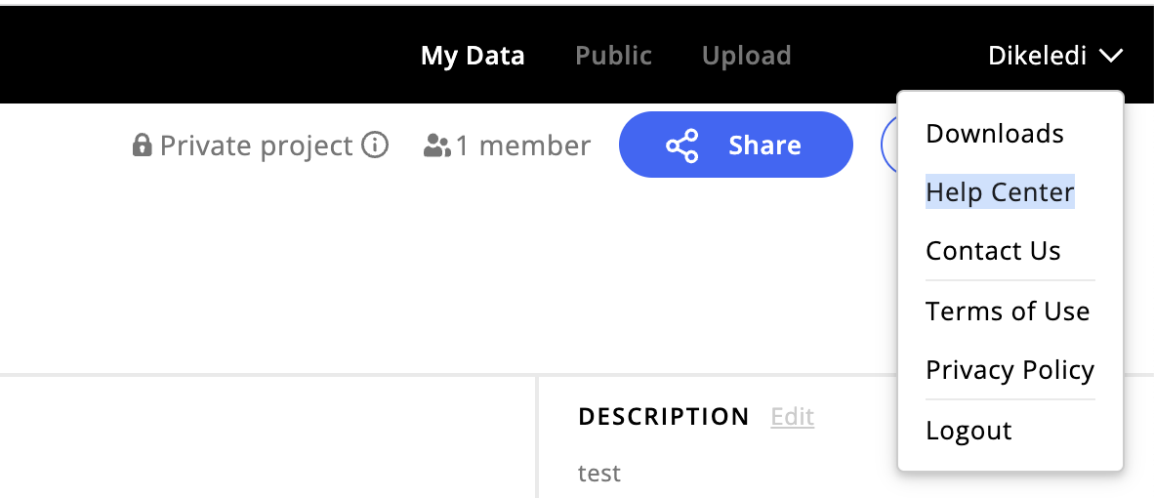
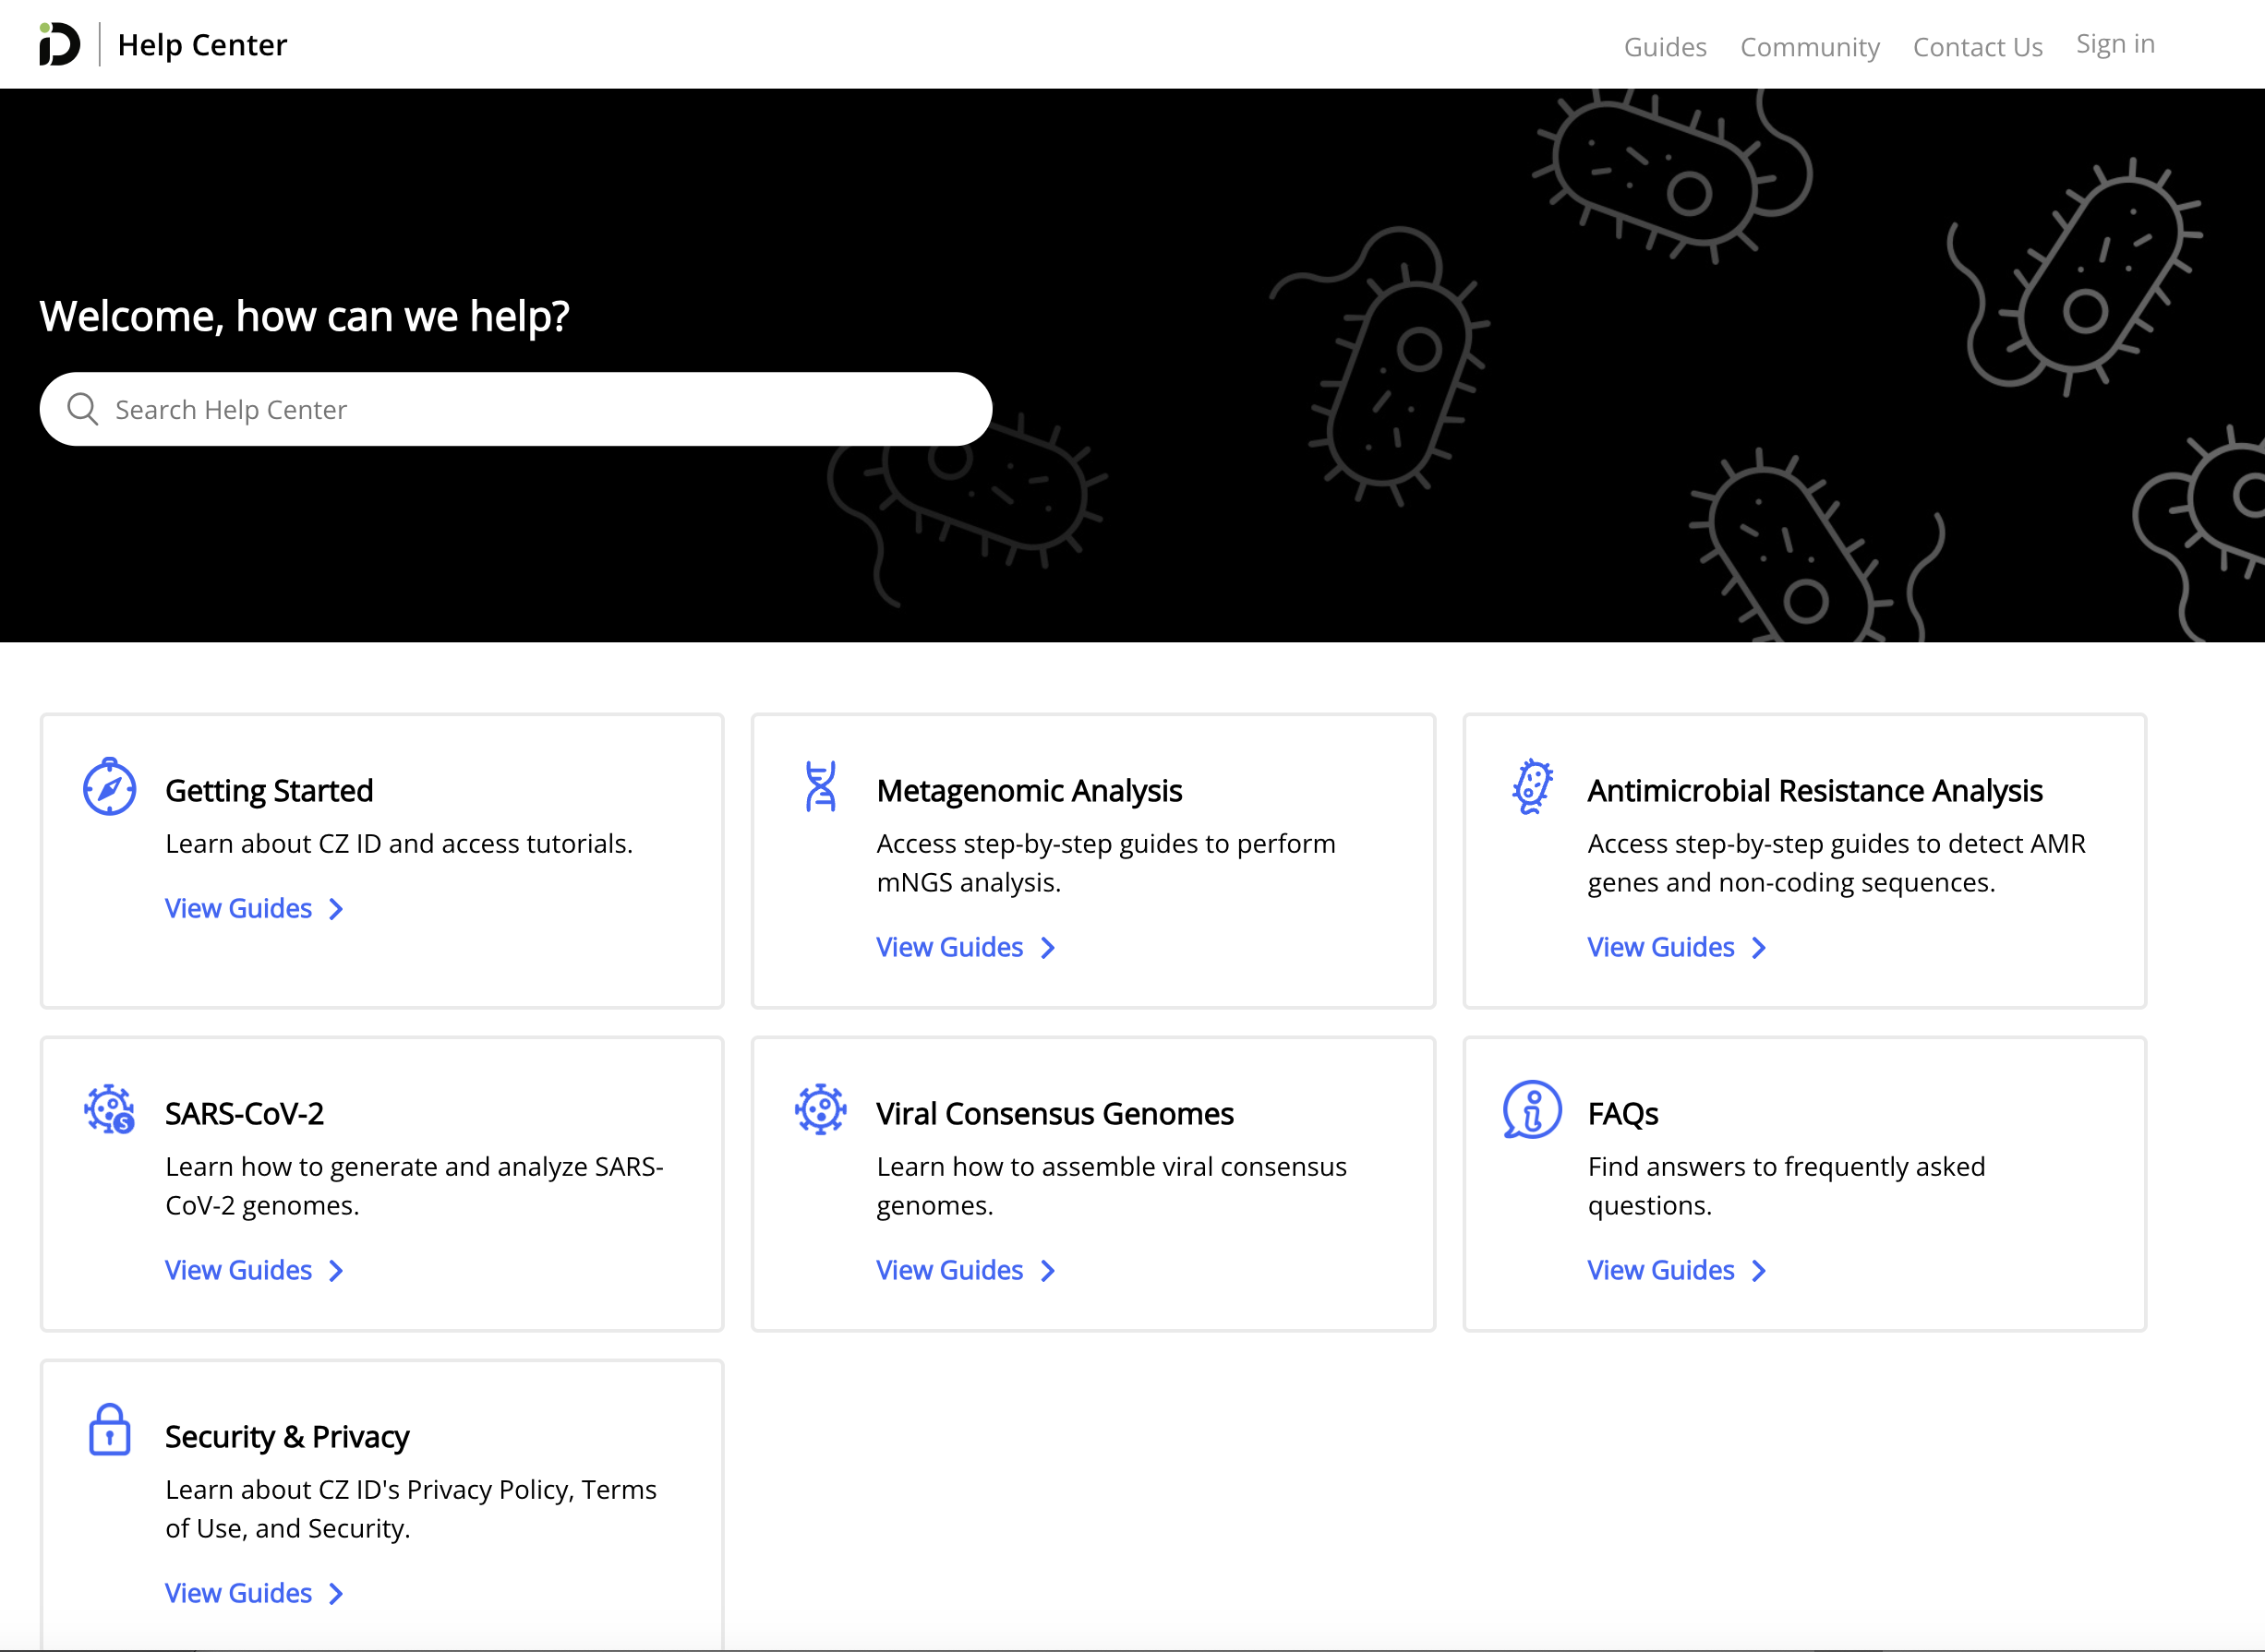
If you need more info on, Visit the help center

Slide 15
Results from our recent run
PCR positive/negative samples, Flu, WHO EQAP, Avian flu strains

Slide 16
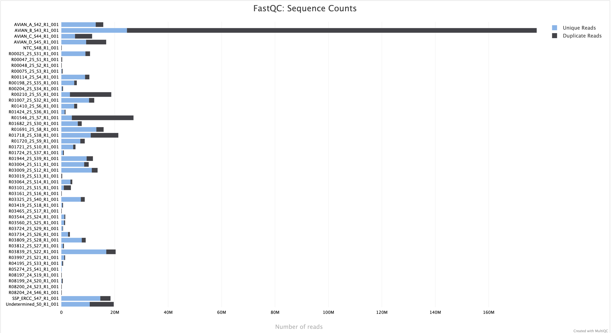
Read distribution per sample
Three viruses failed sequencing (R05274_25. R03465_25, R03161_25)

Slide 17
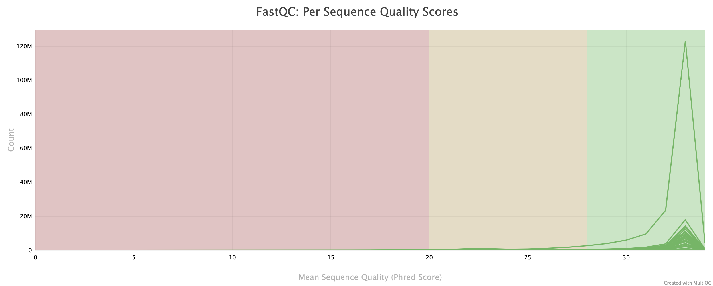
Quality (Phred) score for the run

Slide 18
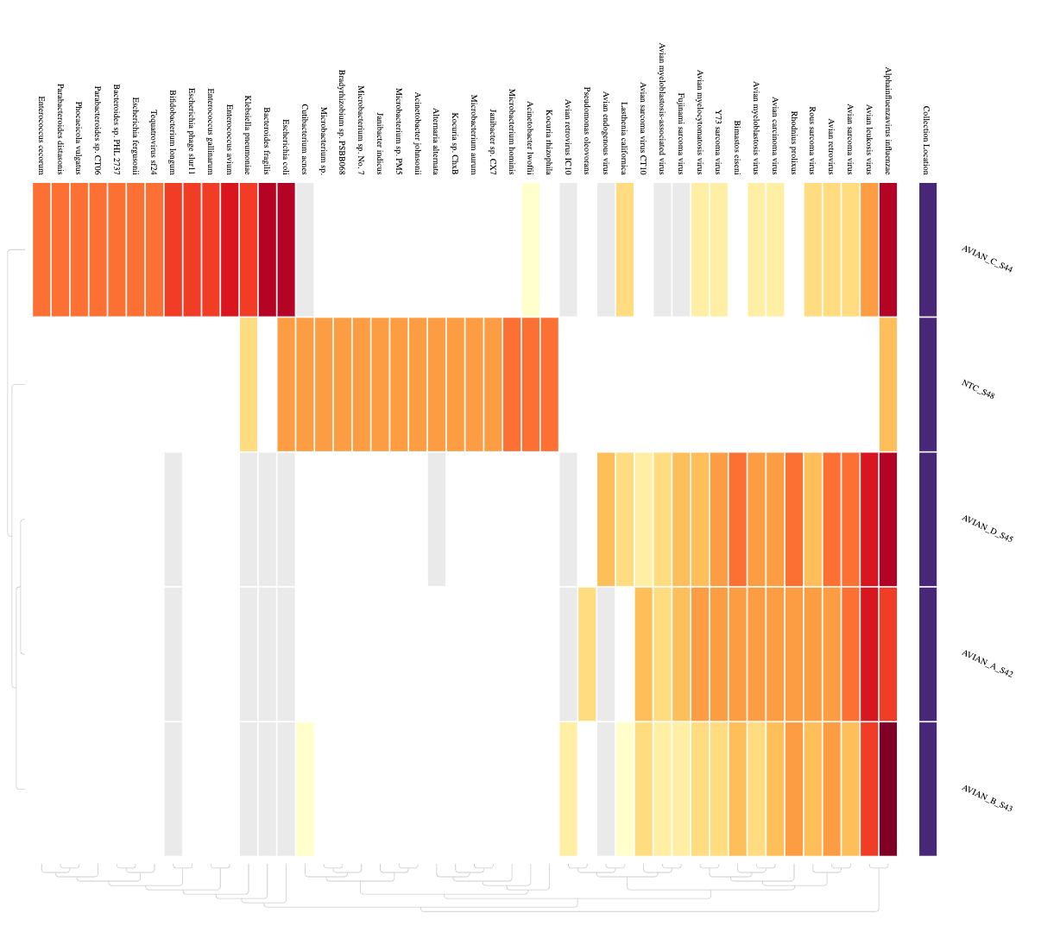
Heatmap showing VIR detections from the avian influenza samples
Criteria for detection: >25% coverage at 1x depth

Slide 19
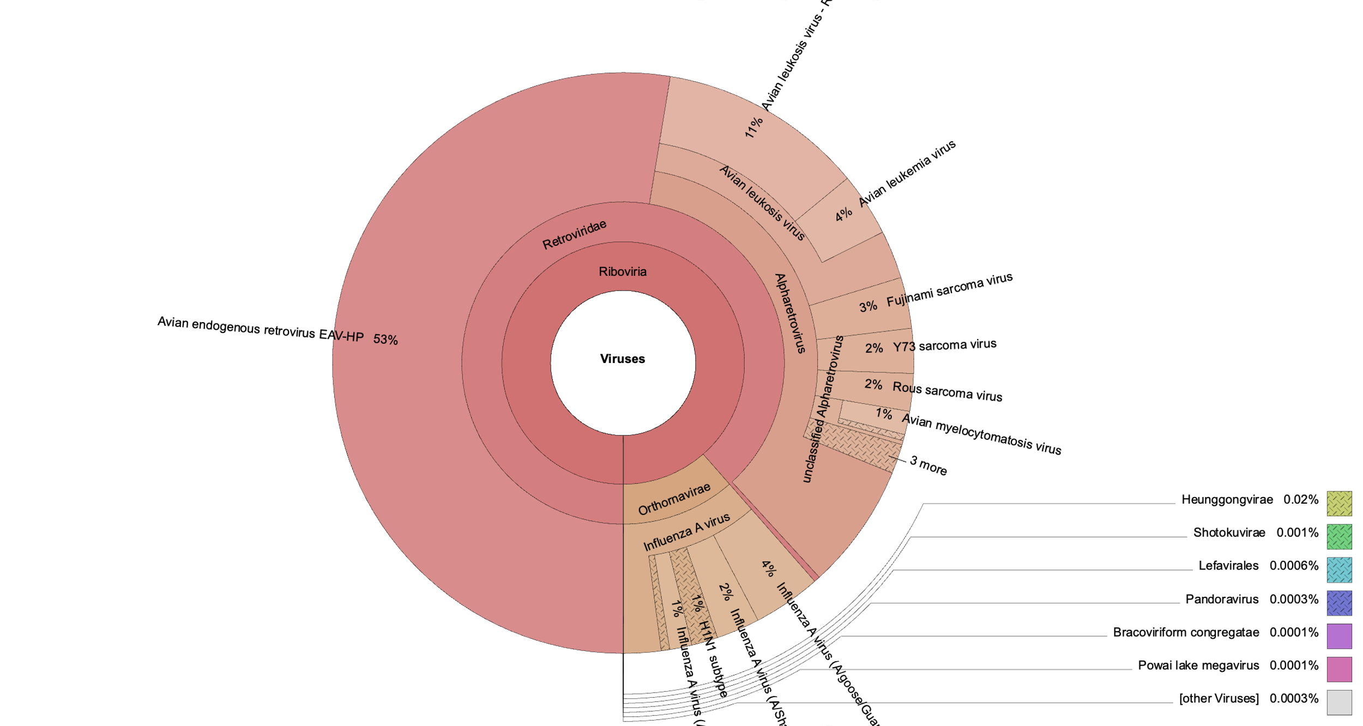
Avian A
92% of the reads from this sample did not have any hits. 6% were assigned to viruses. 53% of the viral reads belonged to Avian endogenous retrovirus. Influenza subtype (H5N1) was confirmed by ~8000 reads (>90% coverage) for the HA and NA (each). (other subtypes on the krona plot are due to hits from the other segments). Bacteria contributed 0.07% of the reads

Slide 20
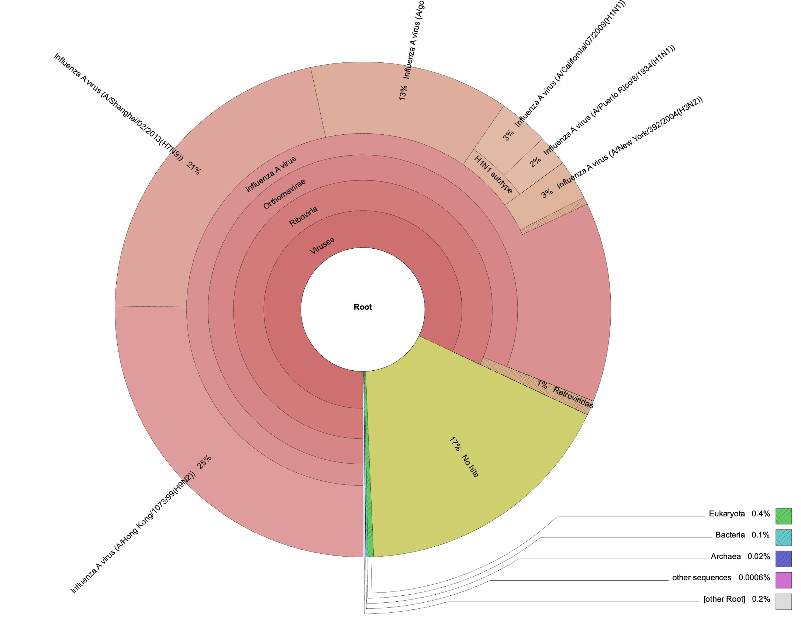
Avian B
85% were assigned to viruses. 16% of the viral reads belonged to Influenza viruses. Influenza subtype (H5N2) was confirmed by >20 million reads (100% coverage) for the HA and NA. Bacteria contributed 0.1% of the reads. 17% of the reads from this sample did not have any hits.

Slide 21
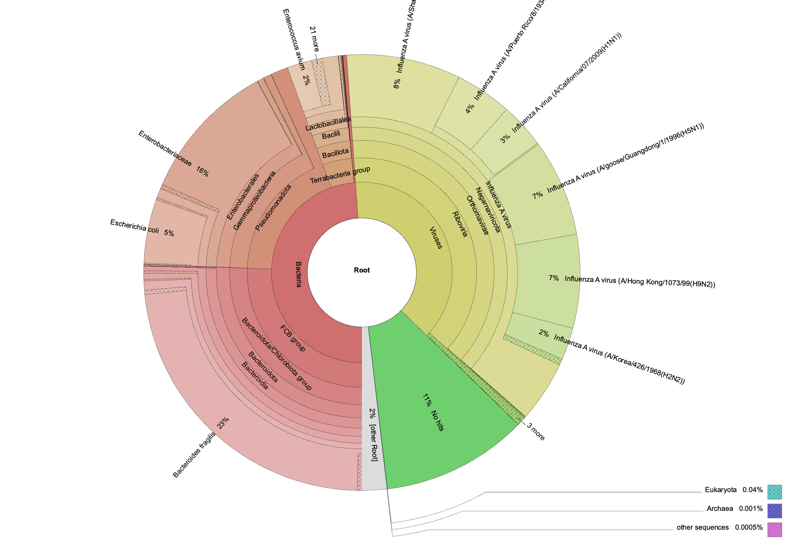
Avian C
38% were assigned to viruses. 53% of the viral reads belonged to Influenza viruses. Influenza subtype (H5N8) was confirmed by >40 000 reads (100% coverage) for the HA and NA. Bacteria contributed 49% of the reads. 11% of the reads from this sample did not have any hits.

Slide 22
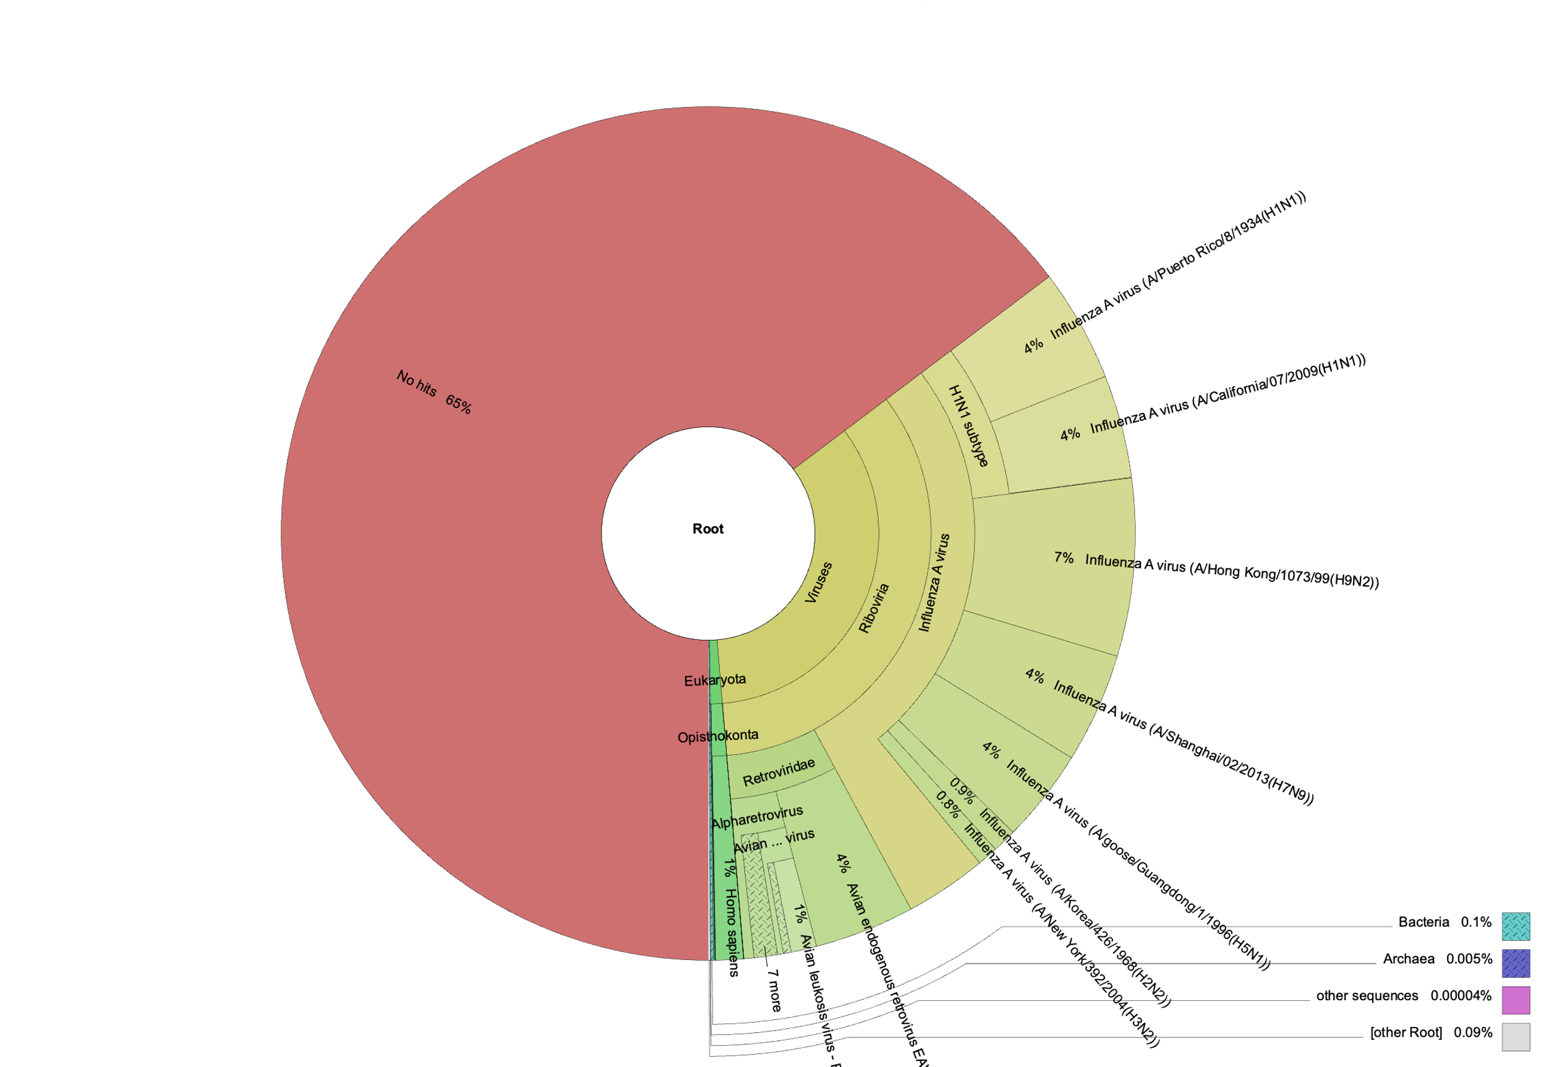
Avian D
34% were assigned to viruses. 25% of the viral reads belonged to Influenza viruses. Influenza subtype (H6N2) was confirmed ads (100% coverage) for the HA and NA. Bacteria contributed 0.1% of the reads. 65% of the reads from this sample did not have any hits.

Slide 23
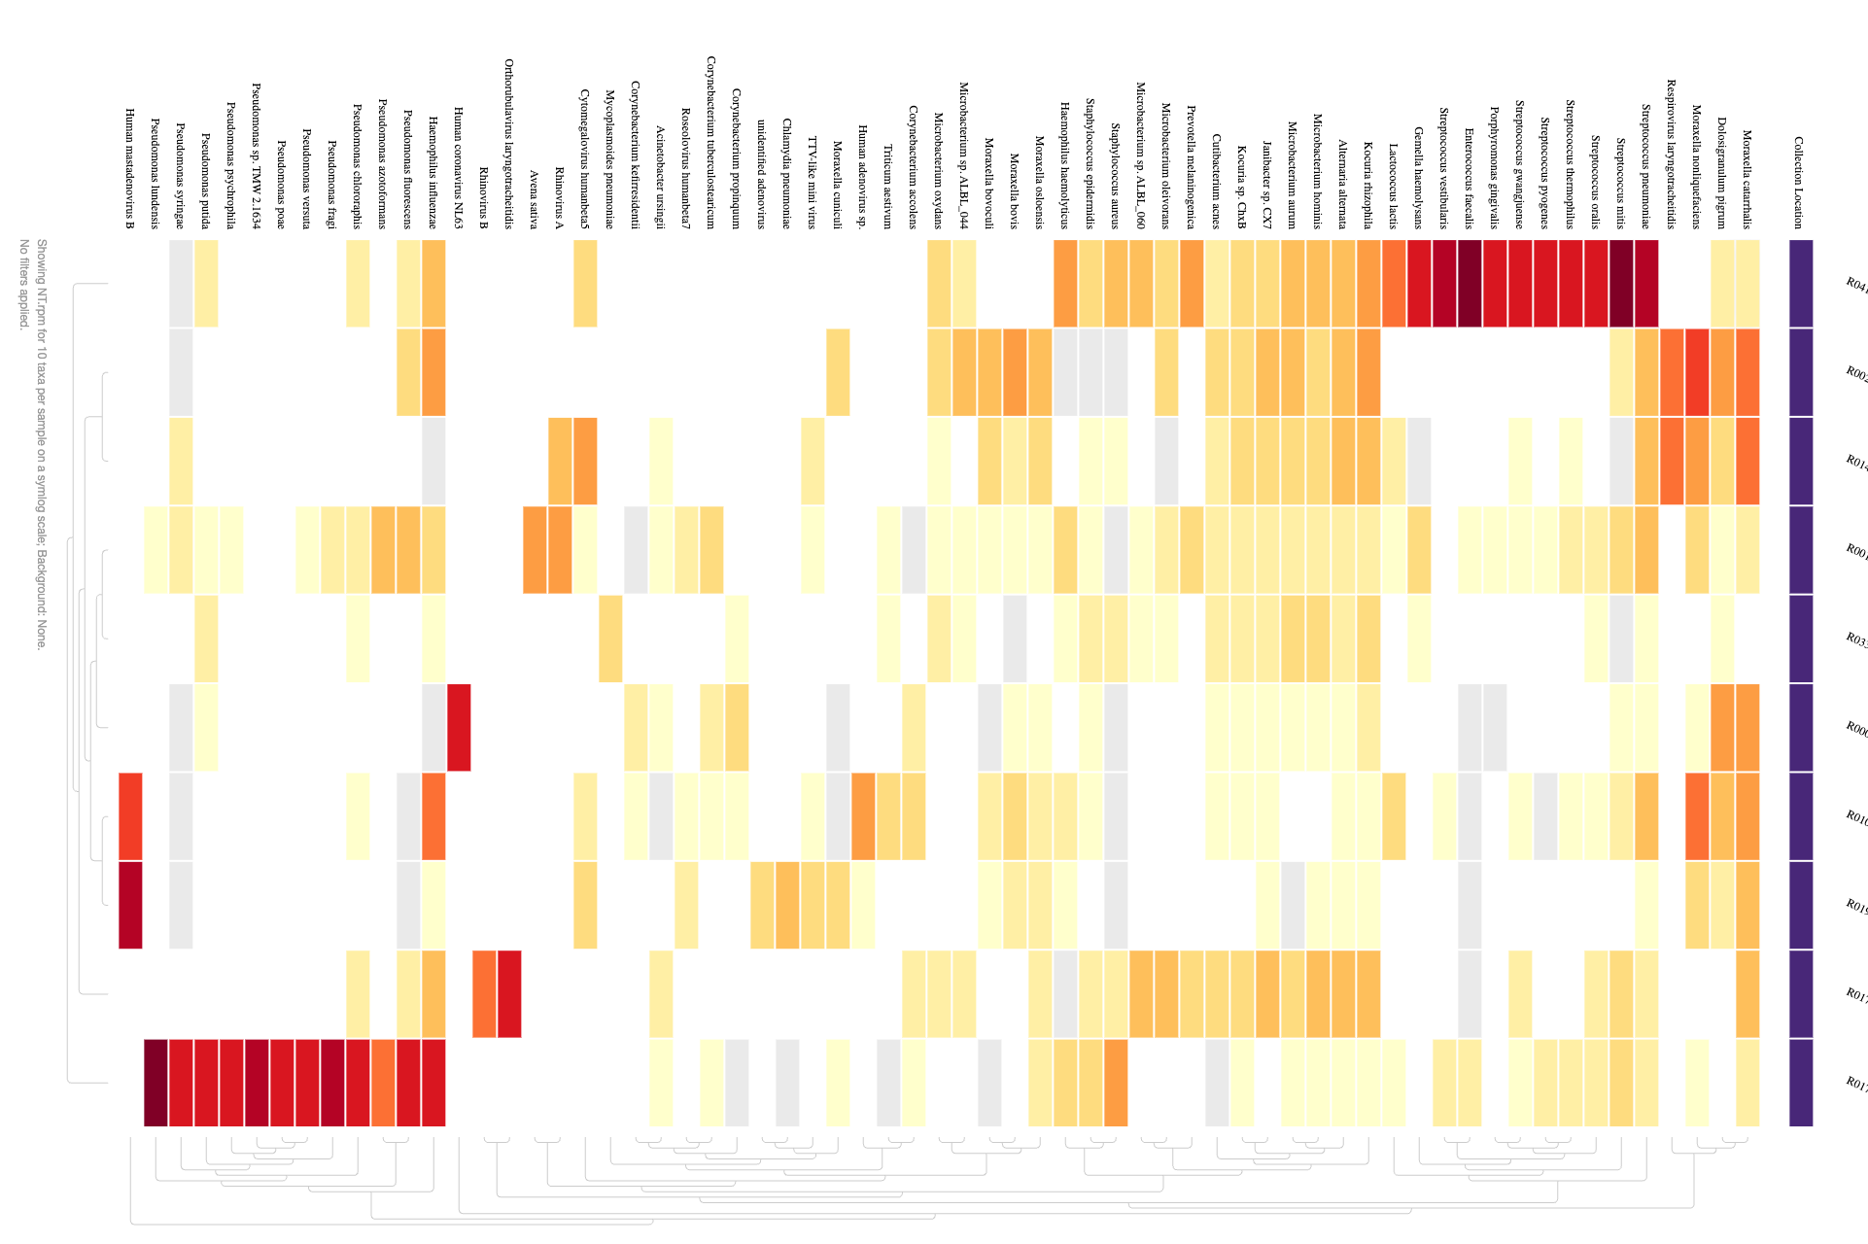
Heatmap showing VIR detections from the PCR positive samples

Slide 24
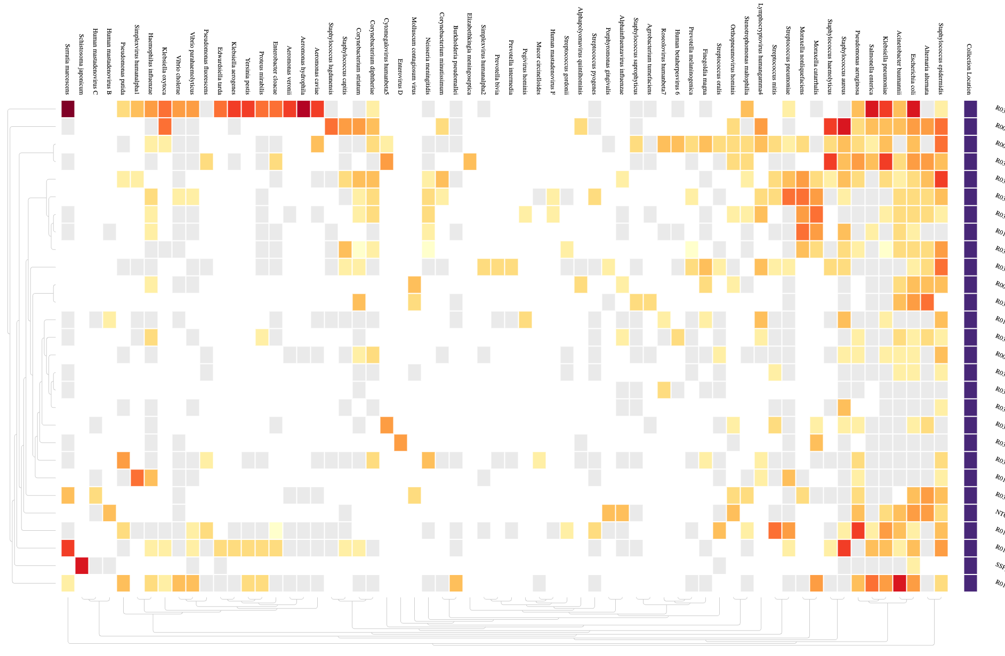
Heatmap showing VIR detections from the PCR negative samples
Abundant known pathogenic species(majority of which are bacteria) include Staph epidermis/aureus, E.coli, Serratia Marcescens, Acetobacter baumannii, Salmonella etc..

Slide 25
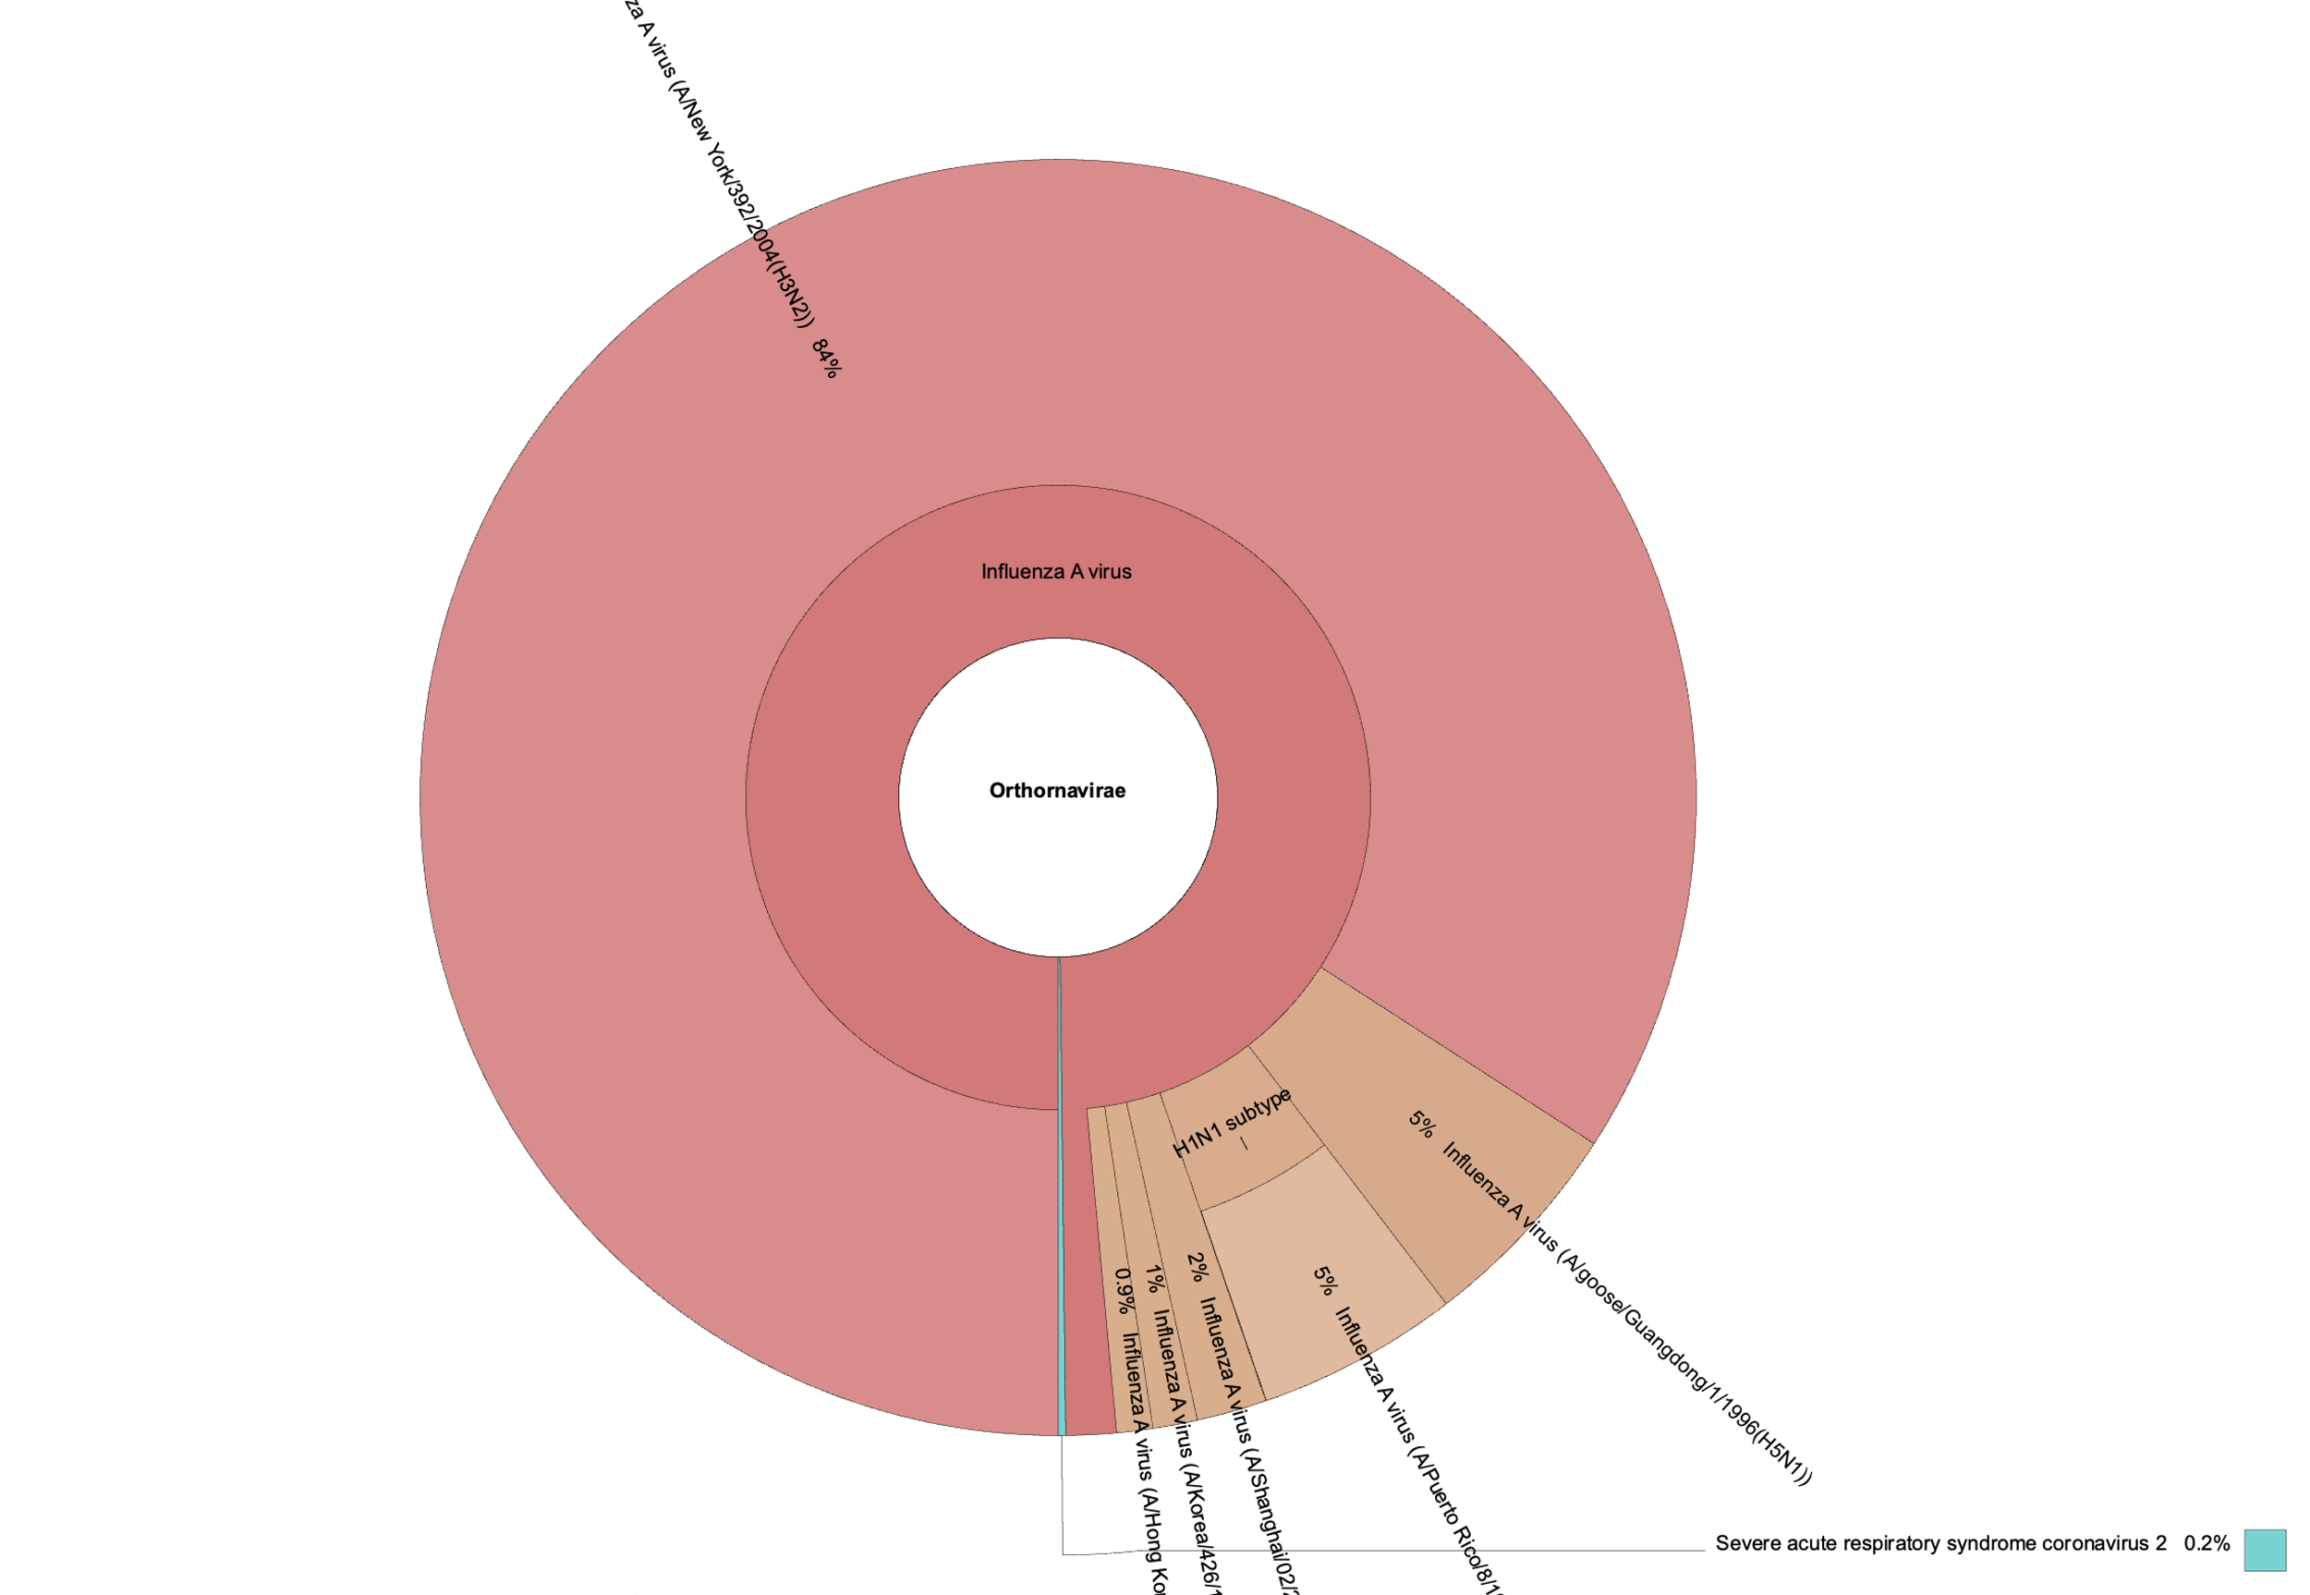
R081_24 (seasonal Influenza possible sample)
Detections include H3N2 influenza and SARS-CoV-2

Slide 26
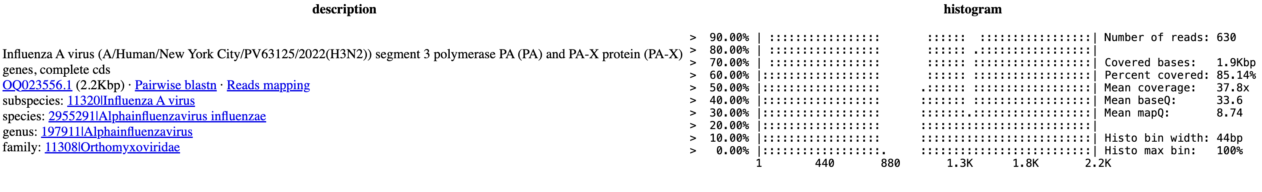
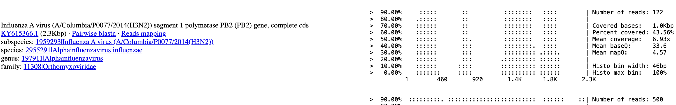
Do you find better quality for the polymerases using VirCapSeq?

Slide 27
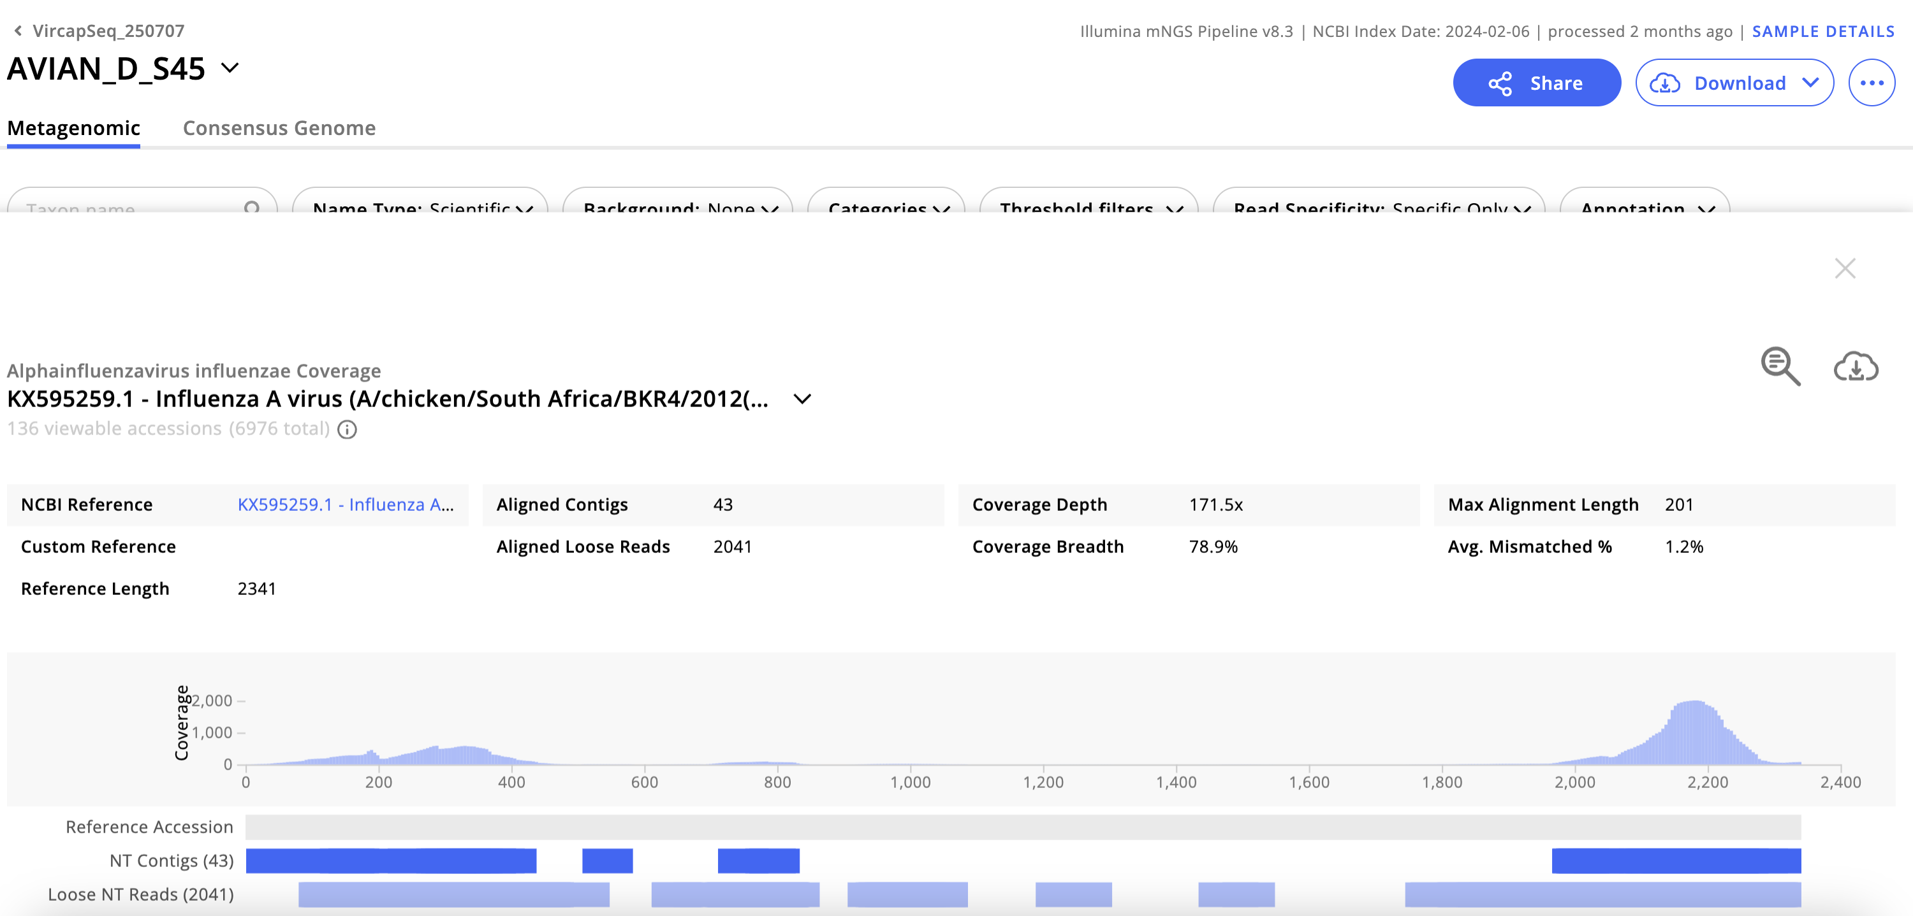
Do you find better quality for the polymerases using VirCapSeq?

